Slide 1
Part 2: Spring application essentials
Framework features that Spring provides for building enterprise applications
Topics:
Hitting the database– guide you in using Spring’s support for data persistence
Managing transactions – learn how to declaratively apply transactional policies to your application objects using AOP
Building web applications with Spring MVC
Working with Spring Web Flow– conversational, flow-based web applications
Securing Spring - protect the information your application contains

Slide 2
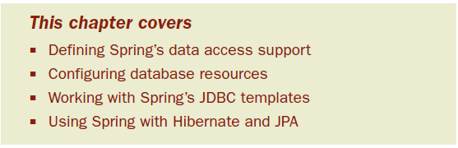
Chapter 5: Hitting the database
Put it to work into real applications
Persisting data- a requirement of nearly any enterprise application
Notes:
-In practice, we know that data access has many pitfalls. We have to initialize our data access framework, open connections, handle various exceptions, and close connections. If we get any of this wrong, we could potentially corrupt or delete valuable company data.

Slide 3
Spring comes with a family of data access frameworks that integrate with a variety of data access technologies.
Whether JDBC, iBATIS, or an object relational mapping (ORM) framework such as Hibernate, Spring removes the tedium of data access from your persistence code.
turn your attention to managing your application’s data
Starting in this chapter, we’ll build a Twitter-like application based on Spring called Spitter. The first order of business is to develop Spitter’s persistence layer.
Notes:
We could use JDBC, Hibernate, the Java Persistence API (JPA), or any of a number of persistence frameworks.

Slide 4
5.1 Learning Spring’s data access philosophy
From the previous chapters, you know that one of Spring’s goals is to allow you to develop applications following the sound object-oriented (OO) principle of coding to interfaces.
Spring’s data access support is no exception.
DAO - exist to provide a means to read and write data to the database
Notes:
They should expose this functionality through an interface by which the rest of the application will access them.

Slide 5
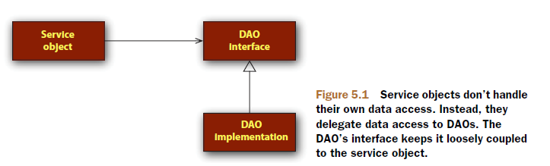
As you can see, the service objects are accessing the DAOs through interfaces.
Easily testable
persistence technology-agnostic manner
Notes:
-If the implementation details of the data access tier were to leak into other parts of the application, the entire application would become coupled with the data access tier, leading to a rigid application design.
-I believe that interfaces are key to writing loosely coupled code and that they should be used at all layers of an application, not just at the data access layer.

Slide 6
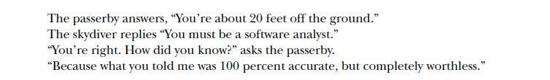
5.1.1 Getting to know Spring’s data access exception hierarchy
Old joke about a skydiver:
If you’ve ever written JDBC code (without Spring), you’re probably keenly aware that you can’t do anything with JDBC without being forced to catch SQLException.
Notes:
SQLException means that something went wrong while trying to access a database. But there’s little about that exception that tells you what went wrong or how to deal with it.

Slide 7
Some common problems that might cause an SQLException to be thrown include:
The application is unable to connect to the database.
The query being performed has errors in its syntax.
The tables and/or columns referred to in the query don’t exist.
An attempt was made to insert or update values that violate a database constraint.
The big question surrounding SQLException is how it should be handled when it’s caught.
Notes:
As it turns out, many of the problems that trigger an SQLException can’t be remedied within a catch block. Most SQLExceptions that are thrown indicate a fatal condition. If the application can’t connect to the database, that usually means that the application will be unable to continue. Likewise, if there are errors in the query, little can be done about it at runtime.

Slide 8
If there’s nothing that can be done to recover from an SQLException, why are we forced to catch it?
SQLException is treated as a one-size-fits-all exception for problems related to data access. Rather than have a different exception type for each possible problem, SQLException is the exception that’s thrown for all data access problems.
Some persistence frameworks offer a richer hierarchy of exceptions.
Hibernate
Notes:
Hibernate, for example, offers almost two dozen different exceptions, each targeting a specific data access problem. This makes it possible to write catch blocks for the exceptions that you want to deal with.

Slide 9
On one hand, JDBC’s exception hierarchy is too generic—it’s not really much of a hierarchy at all. On the other hand, Hibernate’s exception hierarchy is proprietary to Hibernate.
What we need is a hierarchy of data access exceptions that are descriptive but not directly associated with a specific persistence framework.

Slide 10
SPRING’S PERSISTENCE PLATFORM-AGNOSTIC EXCEPTIONS
Spring JDBC provides a hierarchy of data access exceptions that solve both problems.
In contrast to JDBC, Spring provides several data access exceptions, each descriptive of the problem that they’re thrown for

Slide 11
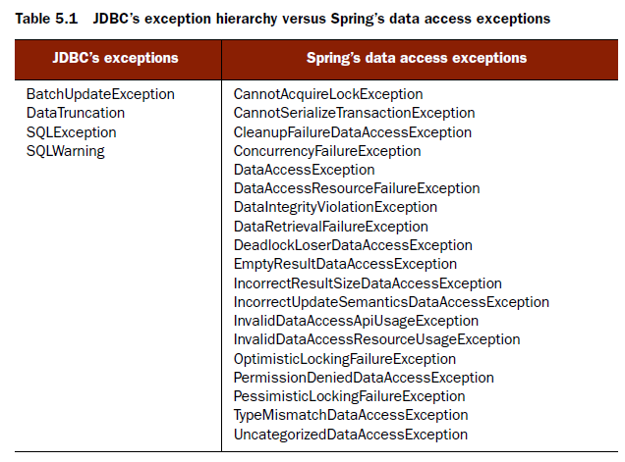

Slide 12
LOOK, MA! NO CATCH BLOCKS!
What isn’t evident from table 5.1 is that all of those exceptions are rooted with DataAccessException.
What makes DataAccessException special is that it’s an unchecked exception.
DataAccessException is just one example of Spring’s across-the-board philosophy of checked versus unchecked exceptions.

Slide 13
Spring takes the stance that many exceptions are the result of problems that can’t be addressed in a catch block. Instead of forcing developers to write catch blocks (which are often left empty), Spring promotes the use of unchecked exceptions. This leaves the decision of whether to catch an exception in the developer’s hands.
To take advantage of Spring’s data access exceptions, you must use one of Spring’s supported data access templates.

Slide 14
5.1.2 Templating data access
Travel Luggage analogy
Security scan
Check-in
Another security scan
Luggage train
For connecting flight: luggage needs to be moved as well
Arrival: remove from train and place in carousel
Baggage claim area
Notes:
-Even though there are many steps to this process, you’re only actively involved in a couple of those steps. The carrier itself is responsible for driving the process. You’re only involved when you need to be; the rest is taken care of.

Slide 15
the Template Method pattern
defines the skeleton of a process
The overall sequence of events for handling luggage occurs the same way every time: luggage is checked in, luggage is loaded onto the plane, and so forth.
Some steps of the process are fixed as well
At certain points, the process delegates its work to a subclass to fill in some implementation-specific details.
In software terms, a template method delegates the implementation-specific portions of the process to an interface.
Different implementations of this interface define specific implementations of this portion of the process.

Slide 16
This is the same pattern that Spring applies to data access.
No matter what technology we’re using, certain data access steps are required.
But each data access method we write is slightly different. These are the variable steps in the data access process.
Spring separates the fixed and variable parts of the data access process into two distinct classes: templates and callbacks.
Notes:
FIXED-For example, we always need to obtain a connection to our data store and clean up resources when we’re done.
VARY-We query for different objects and update the data in different ways.

Slide 17
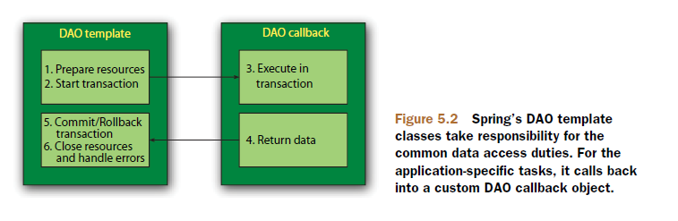
In practice, this makes for an elegant framework because all you have to worry about is your data access logic.

Slide 18
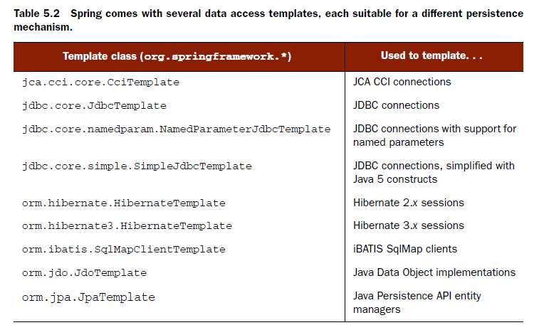
Spring comes with several templates to choose from, depending on your persistence platform choice.

Slide 19
As you’ll see, using a data access template simply involves configuring it as a bean in the Spring context and then wiring it into your application DAO. Or you can take advantage of Spring’s DAO support classes to further simplify configuration of your application DAOs.

Slide 20
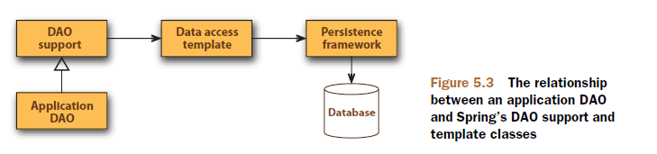
5.1.3 Using DAO support classes
Each template also provides convenience methods that simplify data access without the need to create an explicit callback implementation.

Slide 21
When writing your application DAO implementation, you can subclass a DAO support class and call a template retrieval method to have direct access to the underlying data access template.
For example, if your application DAO subclasses JdbcDaoSupport, then you only need to call getJdbcTemplate() to get a JdbcTemplate to work with.

Slide 22
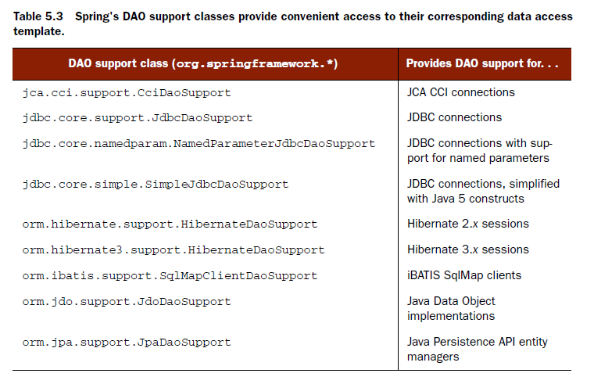
Notes:
We’ll start with basic JDBC access, as it’s the most basic way to read and write data from a database. Then we’ll look at Hibernate and JPA, two of the most popular POJO-based ORM solutions.
-But first things first—most of Spring’s persistence support options will depend on a data source. So, before we can get started with creating templates and DAOs, we need to configure Spring with a data source for the DAOs to access the database.

Slide 23
5.2 Configuring a data source
Regardless of which form of Spring DAO support you use, you’ll likely need to configure a reference to a data source.
Spring offers several options for configuring data source beans in your Spring application
Data sources that are defined by a JDBC driver
Data sources that are looked up by JNDI
Data sources that pool connections
Notes:
-For production-ready applications, I recommend using a data source that draws its connections from a connection pool. When possible, I prefer to retrieve the pooled data source from an application server via JNDI.

Slide 24

5.2.1 Using JNDI data sources
Spring applications will often be deployed to run within a Java EE application server such as WebSphere, JBoss, or even a web container like Tomcat.
These servers allow you to configure data sources to be retrieved via JNDI.
With Spring, we can configure a reference to a data source that’s kept in JNDI and wire it into the classes that need it as if it were just another Spring bean.
Notes:
The benefit of configuring data sources in this way is that they can be managed completely external to the application, allowing the application to ask for a data source when it’s ready to access the database. Moreover, data sources managed in an application server are often pooled for greater performance and can be hot-swapped by system administrators.

Slide 25
The jndi-name attribute is used to specify the name of the resource in JNDI. If only the jndi-name property is set, then the data source will be looked up using the name given as is. But if the application is running within a Java application server, then you’ll want to set the resource-ref property to true so that the value given in jndi-name will be prepended with java:comp/env/.

Slide 26
5.2.2 Using a pooled data source
If you're unable to retrieve a data source from JNDI, the next best thing is to configure a pooled data source directly in Spring.
Although Spring doesn’t provide a pooled data source, there’s a suitable one available in the Jakarta Commons Database Connection Pooling (DBCP) project (http://jakarta.apache.org/commons/dbcp).

Slide 27
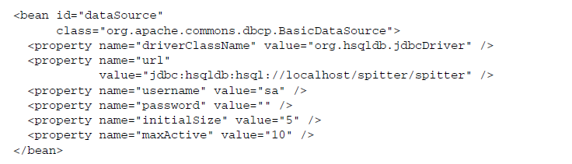
The first four properties are elemental to configuring a BasicDataSource.

Slide 28
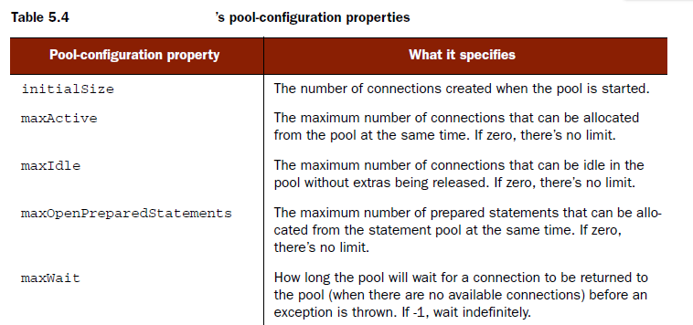
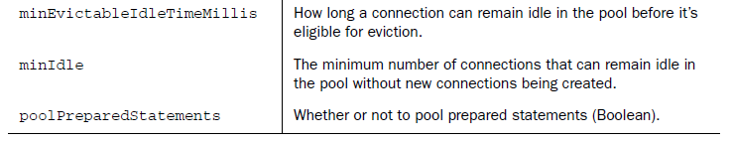

Slide 29
5.2.3 JDBC driver-based data source
The simplest data source you can configure in Spring is one that’s defined through a JDBC driver.
DriverManagerDataSource—Returns a new connection every time that a connection is requested.
SingleConnectionDataSource—Returns the same connection every time a connection is requested.
Notes:
Although SingleConnectionDataSource isn’t exactly a pooled data source, you can think of it as a data source with a pool of exactly one connection.

Slide 30
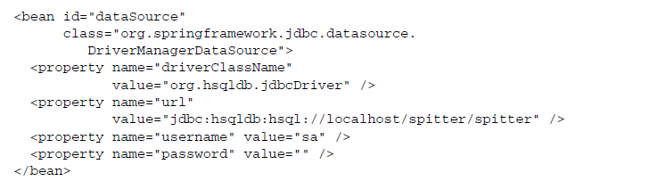
there are no pool configuration properties to set

Slide 31
SingleConnectionDataSource has one and only one database connection to work with - doesn’t work well in a multithreaded application
even though DriverManagerDataSource is capable of supporting multiple threads, it incurs a performance cost for creating a new connection each time a connection is requested.
Pooled datasource is the way to go

Slide 32
Exercise 5-1
Open project ‘spitter-jdbc-datasource-exercise
Run SpitterDaoTest.java – JUnit initially passes
From AbstractSpitterDaoTest, change the config file from ‘test-datasource-context.xml’ to ‘datasource-testcontext.xml’
Verify datasource-testcontext.xml and add needed declarations to configure a pooled datasource using MySQL.
driverClassName = com.mysql.jdbc.Driver
url: jdbc:mysql://localhost:3306/spitter
username: root
password: pa$$w0rd
SpitterDaoTest.java should pass

Slide 33
5.3 Using JDBC with Spring
The tried-and-true method for persisting data is with good old JDBC.
JDBC doesn’t require mastering another framework’s query language.
It’s built on top of SQL, which is the data access language.
finely tune the performance of your data access when you use JDBC than with practically any other technology
But all is not sunny in the world of JDBC. With its power, flexibility, and other niceties also come some not-so-niceties.

Slide 34
5.3.1 Tackling runaway JDBC code
You’re responsible for handling everything related to accessing the database.

Slide 35
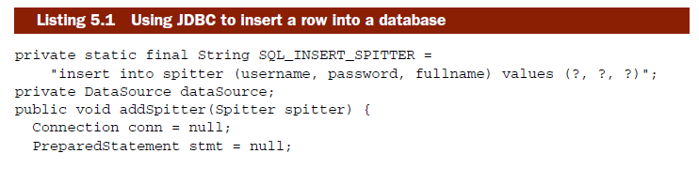
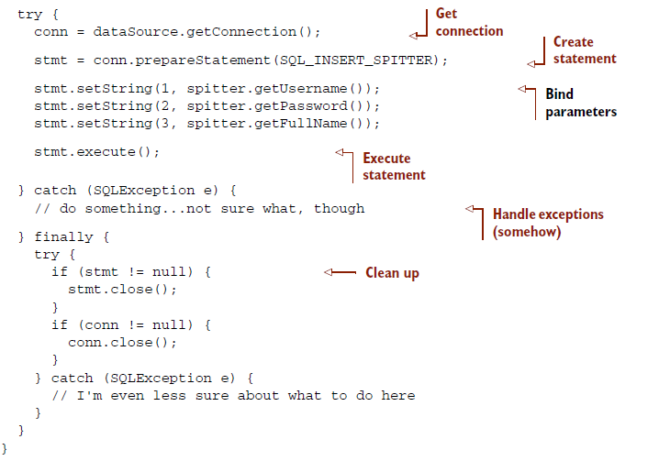

Slide 36
That’s more than 20 lines of code to insert a simple object into a database!
JDBC requires that you properly manage connections and statements and somehow handle the SQLException that may be thrown.
Speaking of that SQLException: not only is it not clear how you should handle it (because it’s not clear what went wrong), but you’re forced to catch it twice!
Seems like a lot of work to handle something that usually can’t be handled programmatically.

Slide 37
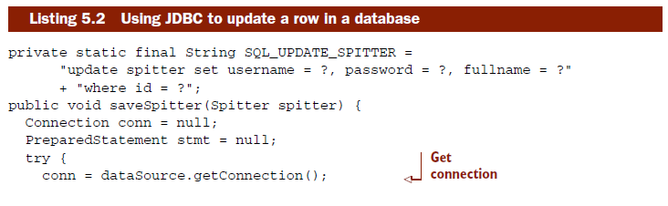
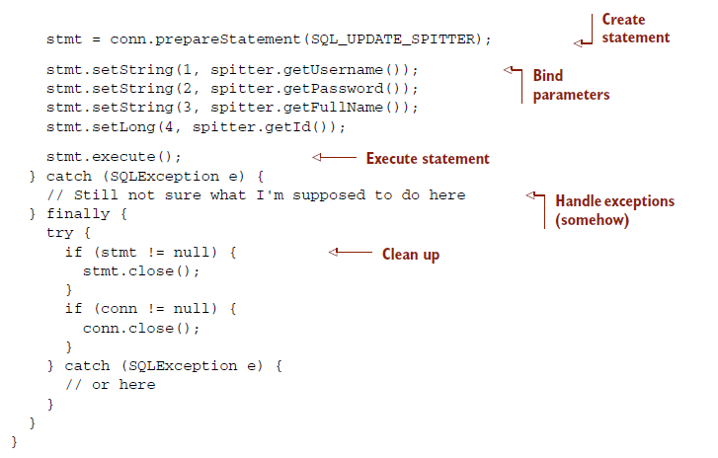

Slide 38
Again, that’s a lot of code to do something as simple as update a single row in a database.
that’s a lot of repeated code. Ideally, we’d only have to write the lines that are specific to the task at hand.
Notes:
To round out our tour of conventional JDBC, let’s see how you might retrieve data out of the database. As you can see in the following, that’s not pretty, either.

Slide 39
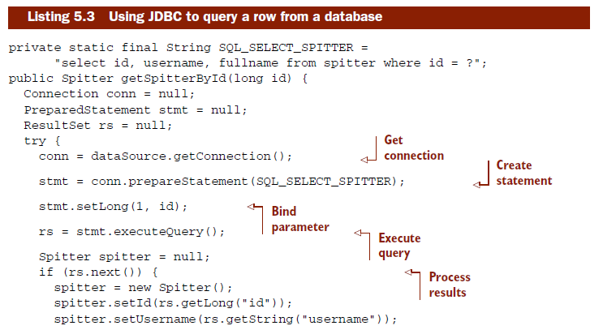
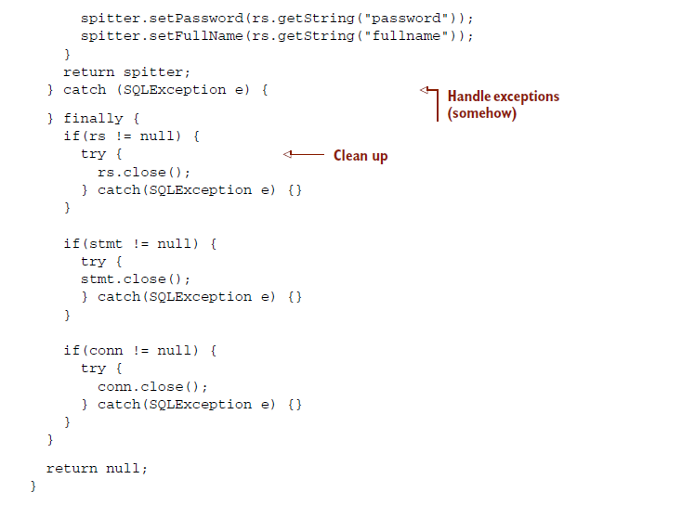

Slide 40
20 percent of the code is needed to actually query a row whereas 80 percent is boilerplate code.
By now you should see that much of JDBC code is boilerplate code for creating connections and statements and exception handling.
But the fact is that this boilerplate code is important.
Notes:
-Cleaning up resources and handling errors is what makes data access robust. Without it, errors would go unde- tected and resources would be left open, leading to unpredictable code and resource leaks. So not only do we need this code, we also need to make sure that it’s correct. This is all the more reason to let a framework deal with the boilerplate code so that we know that it’s written once and written right.

Slide 41
5.3.2 Working with JDBC templates
Spring’s JDBC framework will clean up your JDBC code by shouldering the burden of resource management and exception handling.
This leaves you free to write only the code necessary to move data to and from the database.

Slide 42
For JDBC, Spring comes with three template classes to choose from:
JdbcTemplate—The most basic of Spring’s JDBC templates, this class provides simple access to a database through JDBC and simple indexed-parameter queries.
NamedParameterJdbcTemplate—This JDBC template class enables you to perform queries where values are bound to named parameters in SQL, rather than indexed parameters.
SimpleJdbcTemplate—This version of the JDBC template takes advantage of Java 5 features such as autoboxing, generics, and variable parameter lists to simplify how a JDBC template is used.

Slide 43
In Spring 2.5, the named parameter features of NamedParameterJdbcTemplate were merged into SimpleJdbcTemplate. And as of Spring 3.0, support for older versions of Java (prior to Java 5) has been dropped—so there’s almost no reason to choose the plain JdbcTemplate over SimpleJdbcTemplate.

Slide 44

ACCESSING DATA USING SIMPLEJDBCTEMPLATE
All that a SimpleJdbcTemplate needs to do its work is a DataSource.
Now we can wire the jdbcTemplate bean into our DAO and use it to access the data- base.

Slide 45
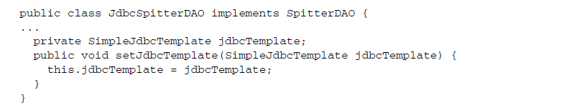
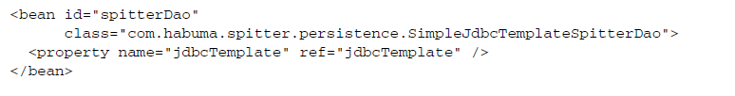

Slide 46
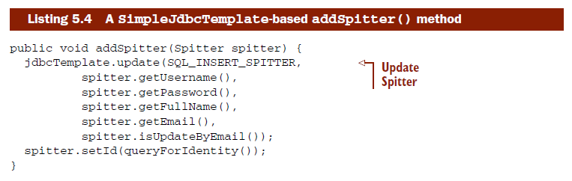
The new SimpleJdbcTemplate-based addSpitter():
There’s nothing but pure data insertion code.
Notes:
I think you’ll agree that this version of addSpitter() is significantly simpler. There’s no more connection or statement creation code—and no more exception-handling code.

Slide 47
Just because you don’t see a lot of boilerplate code, that doesn’t mean it’s not there.
When the update() method is called, SimpleJdbcTemplate will get a connection, create a statement, and execute the insert SQL.
Internally, SimpleJdbcTemplate will catch any SQLExceptions that are thrown. It’ll then translate the generic SQLException into one of the more specific data access exceptions from table 5.1 and rethrow it.
Spring’s data access exceptions are all runtime exceptions.

Slide 48
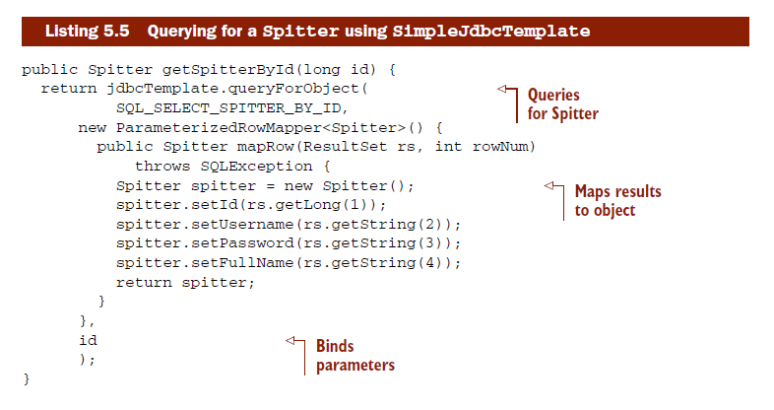
Reading data is also simplified with JdbcTemplate.

Slide 49
This getSpitterById() method uses SimpleJdbcTemplate’s queryForObject() method to query for a Spitter from the database.
The queryForObject() method takes three parameters:
A String containing the SQL to be used to select the data from the database
A ParameterizedRowMapper object that extracts values from a ResultSet and constructs a domain object (in this case a Spitter)
A variable argument list of values to be bound to indexed parameters of the query

Slide 50
For every row that results from the query, JdbcTemplate will call the mapRow() method of the RowMapper.
Just like addSpitter(), the getSpitterById() method is free from JDBC boilerplate code.

Slide 51
USING NAMED PARAMETERS
The addSpitter() method in listing 5.4 used indexed parameters. If we were to ever change the SQL in such a way that the order of the parameters would change, we’d also need to change the order of the values.
Named parameters let us give each parameter in the SQL an explicit name and to refer to the parameter by that name when binding values to the statement.

Slide 52

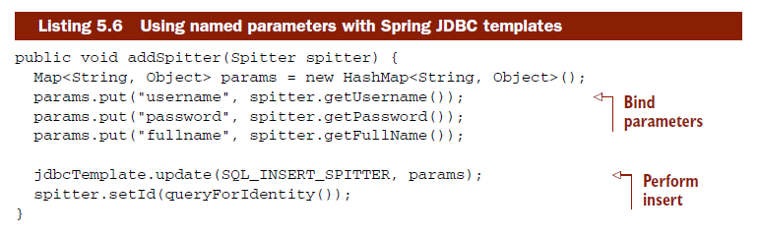
named parameters are bound through a java.util.Map.

Slide 53
Exercise 5-2
Open project ‘spitter-jdbc-template-exercise
Run SpitterDaoTestSimple.java – JUnit initially passes
Wire jdbcTemplate bean into JdbcSpitterDao.java
From persistence-context.xml, change the spitterDao bean declaration, instead of injecting for the property datasource of JdbcSpitterDao inject the jdbcTemplate as property
Modify JdbcSpitterDao.addSpitter using the jdbcTemplate
Modify JdbcSpitterDao.getSpitterById using the jdbcTemplate
SpitterDaoTestSimple.java and SpitterDaoTest.java should pass

Slide 54
USING SPRING’S DAO SUPPORT CLASSES FOR JDBC
For each of our application’s JDBC-backed DAO classes, we’ll need to be sure to add a SimpleJdbcTemplate property and setter method. And we’ll need to be sure to wire the SimpleJdbcTemplate bean into the SimpleJdbcTemplate property of each DAO.

Slide 55
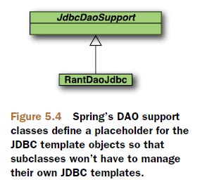
One solution would be for you to create a common parent class for all your DAO objects where the SimpleJdbcTemplate property resides.

Slide 56
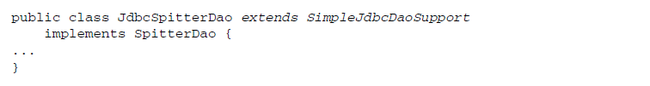
The idea of creating a base DAO class that holds the JDBC template is such a good idea that Spring comes with just such a base class out of the box.
JdbcDaoSupport
SimpleJdbcDaoSupport
NamedParameterJdbcDaoSupport

Slide 57
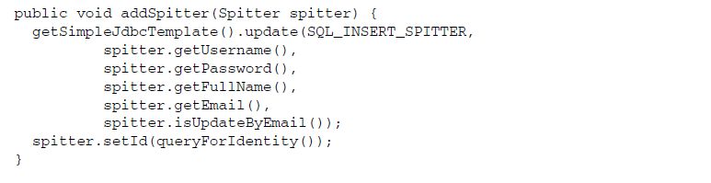
The SimpleJdbcDaoSupport provides convenient access to the SimpleJdbcTemplate through the getSimpleJdbcTemplate() method.

Slide 58

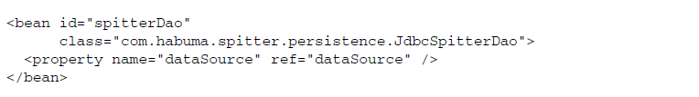
When JdbcSpitterDao has its dataSource property configured, it’ll internally create a SimpleJdbcTemplate instance for you.

Slide 59
Exercise 5-3
Convert current project to using SimpleJdbcDaoSupport
JdbcSpitterDao should extends SimpleJdbcDaoSupport
Delete the properties datasource and jdbcTemplate from JdbcSpitterDao including all setters

Slide 60
5.4 Integrating Hibernate with Spring
JDBC is great for what it does, and for some jobs it works fine. But as our applications become more complex, so do our persistence requirements.
We need to be able to map object properties to database columns and have our statements and queries created for us, freeing us from typing an endless string of question marks.

Slide 61
We also need features that are more sophisticated:
Lazy loading—As our object graphs become more complex, we sometimes don’t want to fetch entire relationships immediately
Eager fetching—allows you to grab an entire object graph in one query.
Cascading—Sometimes changes to a database table should result in changes to other tables as well.
The general name for these services is object-relational mapping (ORM).
Using an ORM tool for your persistence layer can save you literally thousands of lines of code and hours of development time.

Slide 62
Spring provides support for several persistence frameworks, including Hibernate, iBATIS, Java Data Objects (JDO), and the Java Persistence API (JPA).
Spring's support for ORM frameworks provides integration points to the frameworks as well as some additional services:
Integrated support for Spring declarative transactions
Transparent exception handling
Thread-safe, lightweight template classes
DAO support classes
Resource management

Slide 63
Let’s get started by looking at how Spring integrates with what’s perhaps the most popular ORM framework in use—Hibernate.
Hibernate is an open source persistence framework that has gained significant popularity in the developer community.
It provides not only basic object-relational mapping but also all the other sophisticated features you’d expect from a full-featured ORM tool, such as caching, lazy loading, eager fetching, and distributed caching.

Slide 64
5.4.1 A Hibernate overview
As it turns out, Spring’s support for Hibernate offers a similar template class to abstract Hibernate persistence.
Historically, HibernateTemplate was the way to work with Hibernate in a Spring application.
Like its JDBC counterpart, HibernateTemplate took care of the intricacies of working with Hibernate by catching Hibernate-specific exceptions and rethrowing them as one of Spring’s unchecked data access exceptions.

Slide 65
One of the responsibilities of HibernateTemplate is to manage Hibernate Sessions.
The downside of HibernateTemplate is that it’s somewhat intrusive. When we use Spring’s HibernateTemplate in a DAO (whether directly or through HibernateDaoSupport), the DAO class is coupled to the Spring API.
Even though HibernateTemplate is still around, it’s no longer considered the best way of working with Hibernate.
Contextual sessions, introduced in Hibernate 3, are a way in which Hibernate itself manages one Session per transaction.

Slide 66
5.4.2 Declaring a Hibernate session factory
Natively, the main interface for working with Hibernate is org.hibernate.Session.
The Session interface provides basic data access functionality such as the ability to save, update, delete, and load objects from the database.
The standard way to get a reference to a Hibernate Session object is through an implementation of Hibernate’s SessionFactory interface. Among other things, SessionFactory is responsible for opening, closing, and managing Hibernate Sessions.

Slide 67
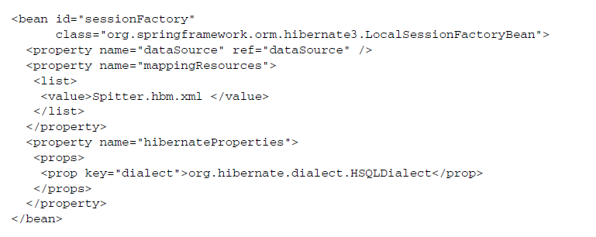
In Spring, the way to get a Hibernate SessionFactory is through one of Spring’s Hibernate session factory beans.
These session factory beans are implementations of Spring’s FactoryBean interface that produce a Hibernate SessionFactory when wired into any property of type SessionFactory.
Notes:
The mappingResources property lists one or more Hibernate mapping files that define the persistence strategy for the application.
Finally, hibernateProperties is where we configure the minutia of how Hibernate should operate.

Slide 68
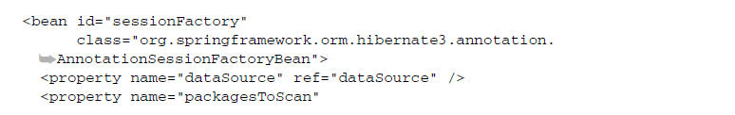
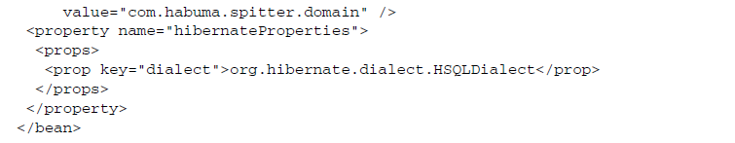
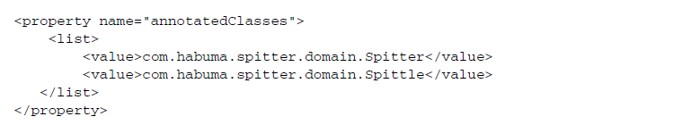
Notes:
we can use the packagesToScan property to tell Spring to scan one or more packages looking for domain classes that are annotated for persistence with Hibernate. This includes classes that are annotated with JPA’s @Entity or @MappedSuperclass and Hibernate’s own @Entity annotation.

Slide 69
5.4.3 Building Spring-free Hibernate
As mentioned before, without contextual sessions, Spring’s Hibernate templates would handle the task of ensuring one session per transaction. But now that Hibernate manages this, there’s no need for a template class. That means that you can wire a Hibernate session directly into your DAO classes.

Slide 70
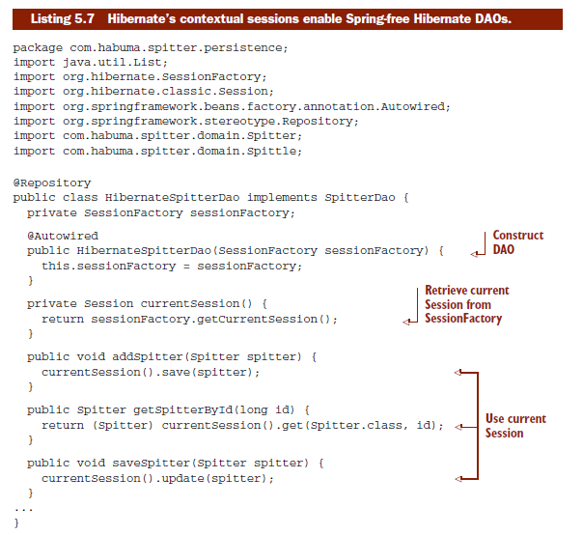

Slide 71
note that we’re using Spring’s @Autowired annotation to have Spring automatically inject a SessionFactory into HibernateSpitterDao's sessionFactory property.
Then, in the currentSession() method, we use that SessionFactory to get the current transaction’s session.
Also note that we’ve annotated the class with @Repository. This means that we won’t have to explicitly declare a HibernateSpitterDao bean, as long as we configure <context:component-scan>

Slide 72
To add exception translation to a template-less Hibernate DAO, we just need to add a PersistenceExceptionTranslationPostProcessor bean to the Spring application context:
PersistenceExceptionTranslationPostProcessor is a bean post processor which adds an advisor to any bean that’s annotated with @Repository so that any platform- specific exceptions are caught and then rethrown as one of Spring’s unchecked data access exceptions.

Slide 73
5.5 Spring and the Java Persistence API
From its beginning, the EJB specification has included the concept of entity beans.
Entity beans both enjoyed the rise and suffered the fall of EJB’s popularity.
In recent years, developers have traded in their heavyweight EJBs for simpler POJO-based development. This presented a challenge to the Java Community Process to shape the new EJB specification around POJOs. The result is JSR-220—also known as EJB 3.

Slide 74
The Java Persistence API (JPA) emerged out of the rubble of EJB 2’s entity beans as the next-generation Java persistence standard.
JPA is a POJO-based persistence mecha-nism that draws ideas from both Hibernate and Java Data Objects (JDO), and mixes Java 5 annotations in for good measure.
With the Spring 2.0 release came the premiere of Spring integration with JPA. The irony is that many blame (or credit) Spring with the demise of EJB. But now that Spring provides support for JPA, many developers are recommending JPA for persistence in Spring-based applications. In fact, some say that Spring-JPA is the dream team for POJO development.

Slide 75
5.5.1 Configuring an entity manager factory
In a nutshell, JPA-based applications use an implementation of EntityManager- Factory to get an instance of an EntityManager.
Application-managed—Entity managers are created when an application directly requests one from an entity manager factory.
Container-managed—Entity managers are created and managed by a Java EE container. The application doesn’t interact with the entity manager factory at all. Instead, entity managers are obtained directly through injection or from JNDI.
Notes:
-With application-managed entity managers, the application is responsible for opening or closing entity managers and involving the entity manager in transactions. This type of entity manager is most appropriate for use in standalone applications that don’t run within a Java EE container.
-

Slide 76
So what does this all mean for Spring developers wanting to use JPA?
Not much. Regardless of which variety of EntityManagerFactory you want to use, Spring will take responsibility for managing EntityManagers for you.
Each flavor of entity manager factory is produced by a corresponding Spring fac- tory bean:
LocalEntityManagerFactoryBean produces an application-managed EntityManagerFactory.
LocalContainerEntityManagerFactoryBean produces a container-managed EntityManagerFactory.

Slide 77
Spring’s JpaTemplate hides the intricate details of dealing with either form of EntityManagerFactory, leaving your data access code to focus on its true purpose: data access.

Slide 78
CONFIGURING APPLICATION-MANAGED JPA
Application-managed entity manager factories derive most of their configuration information from a configuration file called persistence.xml. This file must appear in the META-INF directory within the classpath.

Slide 79
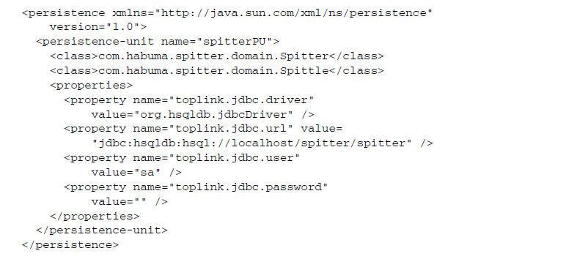


Slide 80
CONFIGURING CONTAINER-MANAGED JPA
Container-managed JPA takes a different approach. When running within a container, an EntityManagerFactory can be produced using information provided by the container—Spring, in our case.
Instead of configuring data source details in persistence.xml, you can configure this information in the Spring application context.

Slide 81
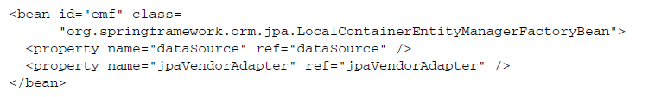
The jpaVendorAdapter property can be used to provide specifics about the partic- ular JPA implementation to use.
EclipseLinkJpaVendorAdapter
HibernateJpaVendorAdapter
OpenJpaVendorAdapter
TopLinkJpaVendorAdapter

Slide 82
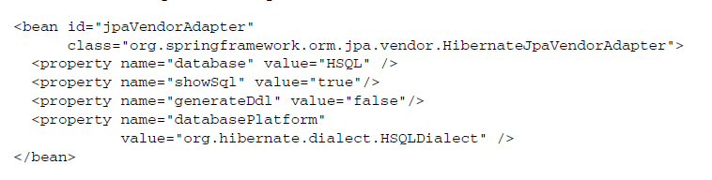
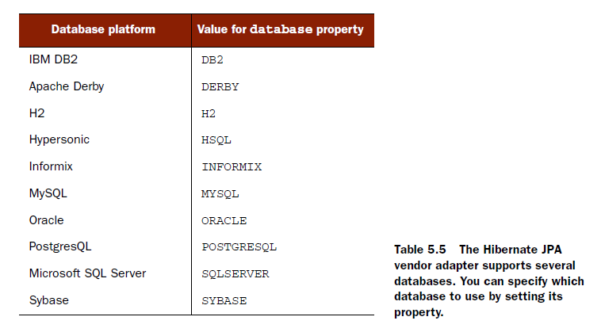

Slide 83
PULLING AN ENTITYMANAGERFACTORY FROM JNDI
It’s also worth noting that if you’re deploying your Spring application in some applica- tion servers, an EntityManagerFactory may have already been created for you and may be waiting in JNDI to be retrieved.

Slide 84
5.5.2 Writing a JPA-based DAO
Since pure JPA is favored over template-based JPA, we’ll focus on building Spring-free JPA DAOs in this section.

Slide 85
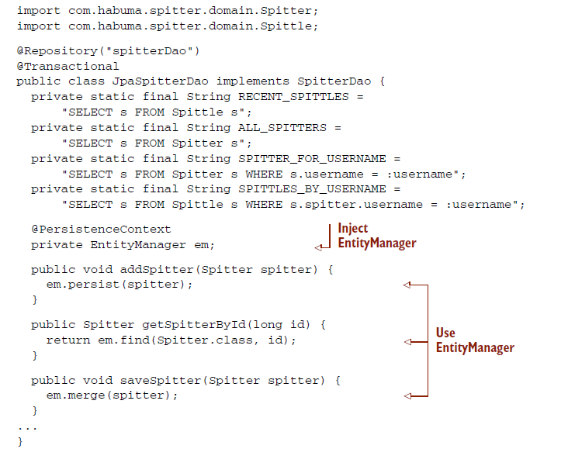

Slide 86
JpaSpitterDao uses a EntityManager to handle persistence. By working with a EntityManager, the DAO remains pure and resembles how a similar DAO may appear in a non-Spring application.
@Transactional indicates that the persistence methods in this DAO will be involved in a transactional context.
As for @Repository, it serves the same purpose here as it did when we developed the Hibernate contextual session version of the DAO.

Slide 87
Speaking of PersistenceExceptionTranslationPostProcessor, we’ll need to remember to wire it up as a bean in Spring just as we did for the Hibernate example:
Note that exception translation, whether it be with JPA or Hibernate, isn’t mandatory.
But if you do use Spring’s exception transla- tion, you’ll be unifying all of your data access exceptions under Spring’s exception hierarchy, which will make it easier to swap out persistence mechanisms later.

Slide 88
-End of Chapter 5-

